Slide 1
COLLEGE OF INFORMATION AND COMMUNICATION TECHNOLOGY(CoICT).
PROJECT TITLE: SCHOOL BUS TRACKING MANAGEMENT SYSTEM
STUDENT NAME: NGAKWIRA,TUMANIEL T. 2020-04-09497 Bsc in CS.
MWAISELA, PETER ABEL. 2020-04-08600 Bsc in BIT.
SUPERVISOR NAME: Mr. MARCO MASEMBO.

Slide 2
INTRODUCTION.
BACKGROUND.
Safety of children has become a major concern for many parents in the recent years.
Due to various responsibilities, parents are unable to pick up their kids to school and later to bring them home.
Thus most of students tend to use school buses but this has caused the parents to worry about kids safety specifically to the arrival time of school bus, location of bus taking kids and others.

Slide 3
PROBLEM STATEMENT.
School buses take long to arrive at students pick-up points.
Drivers are unfamiliar to the routes (pick-up points) of students
Delaying of information to both parents and school administration once an emergence occur during transportation of students.

Slide 4
OBJECTIVES.
Main objective.
To develop School Bus Tracking Management System(SBTMS) which will keep parent directly informed and notified easy about the movements of their children.
Specific objectives.
To conduct a survey to identify the need for School Bus Tracking Management System.
To establish requirements for the School Bus Tracking Management System from stake holders
To design School Bus Tracking Management System from the gathered requirements.
To implement the design of the system

Slide 5
Significance of SBTMS
The system helps to reduce the waiting time of parents and students waiting for the school bus.
The system helps the school administration to keep track and monitor the route of the school buses
The system acts as a directive to new drivers to know pickup points of the students
The system gives notification to the parents and school administration about any emergency that has occurred.

Slide 6
Scope of SBTMS
The scope of this project is based on nursery and primary school students, parents, drivers and school administration. Therefore we will have three modules which are:
Parent
Driver
School administration.

Slide 7
Division of work
Drivers and parents modules will use mobile app and the one who will be responsible to develop this section is Mr. Mwaisela, Peter Abel.
School administrator will use web based system and the one who will be responsible to develop this section is Mr. Ngakwira, Tumainiel T.

Slide 8
LITERATURE REVIEW
A literature review involves the process of survey of the major writings and other sources that provides an overview of a selected topic. The following are reviewed existing solution which are:
Bustracker ( https://bustracker.co.tz/)
Schoolbus (https://multics.co.tz/products/schoolbus)

Slide 9
METHODOLOGY
The existing solution uses waterfall methodology for its development, this because it emphasize linear progressive of stages from beginning to the end of project. This approach has various stages which are:
Requirements gathering and Analysis
Design
Development

Slide 10
TENTATIVE BUDGET
Stationary
Internet connection
. Global position System(GPS)

Slide 11
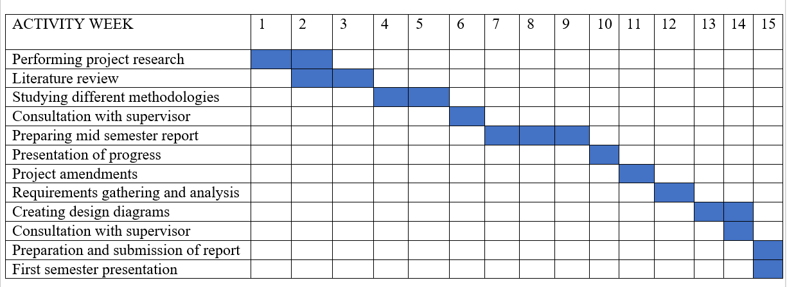
TIME - ACTIVITY SCHEDULE

Slide 12
THANK YOU!

